Slide 1
Silver Oak College Of Engineering & Technology.
Prepared By:
PAREKH PRATIKKUMAR (29)
JATIN DAVE (45)
SHAH PEARL NEELAMKUMAR (58)
Guided By: Prof. Hasumati Patel

Slide 2
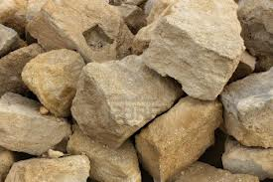
STONE
Stone: A natural engineering material mainly derived from rocks.
They are available in variety of colors, form and structures.
Stones are strong, durable and descent in appearance.

Slide 3
Classification on Stones
Mainly classified in 3 ways..
1) Geological Classification
Igneous Rocks
Sedimentary Rocks
Metamorphic Rocks
2) Physical Classification
Stratified Rocks
Unstratified Rocks
Foliated Rocks

Slide 4
3) Chemical Classification
Siliceous Rocks
Argillaceous Rocks
Calcareous Rocks

Slide 5
Uses of stone
STONES ARE USED FOR,
Foundations, columns, walls, lintels, arches, floors, damp proof courses, sills etc..
Heavy engg. Works i.e. Dams, Docks, Bridges, Piers, retaining walls, abutments, lighthouses etc..
Paving of roads, footpaths etc..
Railways tracks as ballast.

Slide 6
Required Properties of Good Stone
Structure
Texture
Strength
Hardness
Durability
Water Absorption
Specific Gravity
Resistance to fire
Facility of dressing
Appearance and color

Slide 7
BUILDING MATERIAL: BRICKS

Slide 8
BRICKS
Composition:
Material | Amount of composition
Alumina | 20-30 %
Silica | 50-60%
Lime | 4-6%
Iron Oxides | 4-6%
Magnesium | A small Quantity

Slide 9
Types of Bricks
Traditional Bricks:
Size:: 23 cm * 11.4 cm * 7.6 cm
Modular Bricks:
Size :: 19 cm * 9 cm * 9 cm

Slide 10
Classification of Bricks
First Class Bricks : Used for Superior work of permanent nature
Second Class Bricks : Used for making ballast
Third Class Bricks : Used for inferior and unimportant works
Fourth Class Bricks : Used as aggregate for concrete in foundations, floors, roads etc..

Slide 11
Qualities of Good Brick
Bricks should have,
Regular size and shape,
Uniform and brick-red color,
Low thermal conductivity,
Good strength,
Enough hardness,
Sound proof,
Metallic ringing sound when two bricks are struck together..

Slide 12
BUILDING MATERIAL :
LIME

Slide 13
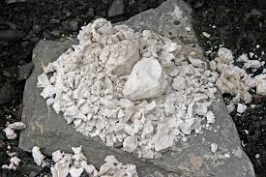
LIME
Important cementing material used in engineering construction.
It is the material which has the capacity of holding structural units (like bricks, stones, aggregate) together with sufficient strength.
Classification of lime is,
Fat Lime,
Hydraulic lime,
Poor lime.

Slide 14
Properties of lime
Fat Lime,
Hardens very slowly,
Slakes vigorously,
Has a high degree of plasticity,
Has perfectly white color.
Hardens in combination with air,

Slide 15
Hydraulic lime,
Hardens in combination with water,
Contains 5-30 % of water,
Does not shrink much,
Is not perfectly white colored,
Forms a thin paste with water,
Slakes very slowly.
Poor lime,
Contains more than 30% of clay,
Slakes and sets very slowly.

Slide 16
USES OF LIME
Whitewashing and plastering of walls,
Preparation of mortar for thick walls, damp places etc.,
Construction under water,
First class brick and stone masonry works,
For inferior works,
Production of good mortar.

Slide 17
BUILDING MATERIAL : BITUMEN

Slide 18
BITUMEN
The Bitumen is a binding material which is present in asphalt.
It is black in color and obtained in solid/semi solid state.
Bituminous materials are very commonly used in highway construction and pavements.

Slide 19
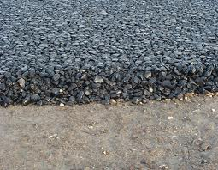
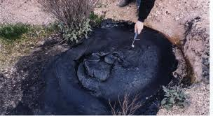
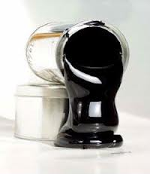
Classification of Bitumen
Asphalt,
Tar,
Cut-back,
Emulsion.

Slide 20
Functions of Bituminous Materials
Binding Effect,
Cushion,
Sealing of surface,
Resistance to weathering agents.

